Slide 1
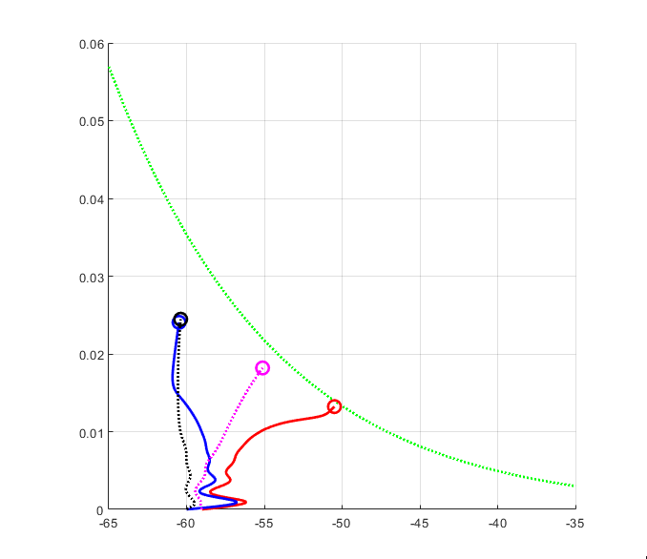
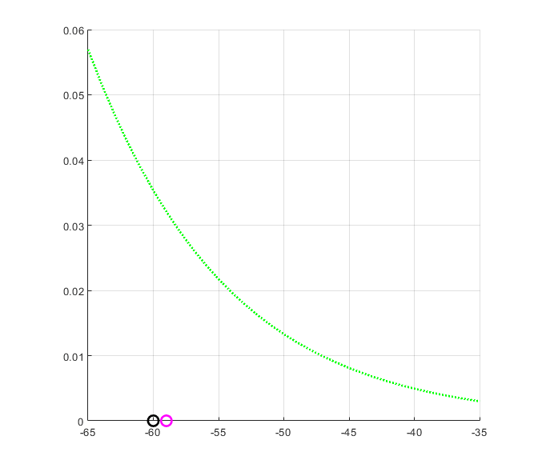
Recall:
FLX for [0 5.23]
FLX for [0.3 0.734]
EXT for [0 5.23]
EXT for [0.3 0.734]
Give the proper stimulus to initiate the oscillation, then stop the input. Gw = 0 goes to stationary.
Give a excitatory stimulus as disturb, the phase plane is shift and change of frequency is not the same.
0.743
3.5
5.23
If we want a desired frequency, say 1.5 Hz. The possible solutions are [Gw D] = [0 5.23]; [0.1 3.5]; [0.3 0.734]. However, the performance for different conductance is not the same. The phase plane size are smaller with large conductance.
Problems: h-nullcline range seems not right ; working on the V-nullcline.
Notes:
1: 0-1.5s
2: 2-4s 2nA

Slide 2
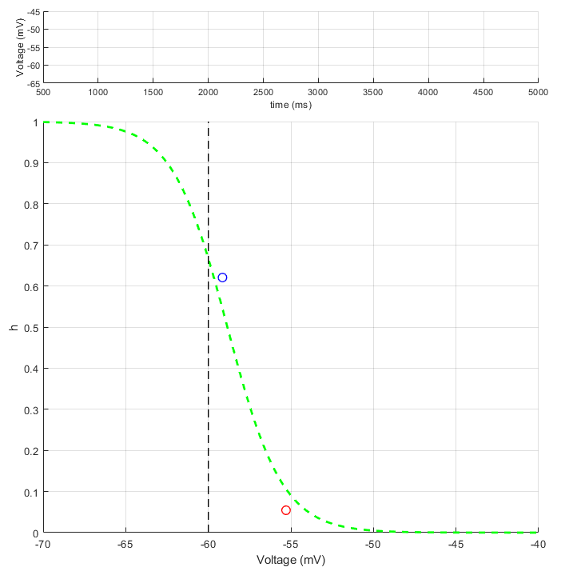
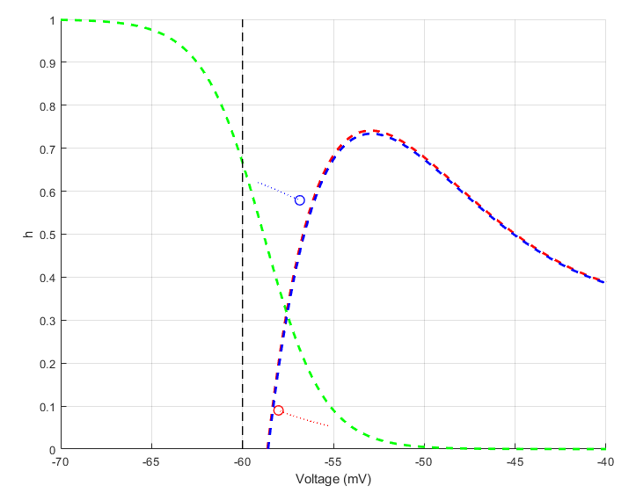
For the h-nullcline range, the problem is due to the reversal potential of h channel. As we increase the reversal channel, we now get the correct h-nullcline range.
Plot of voltage and phase plane over time
Phase plane with V-nullcline (0.5 speed)

Slide 3
As we changed the parameters in sodium channel to get reasonable nullclines (Other parameters did not change), the isochron of CPG also changed. Thus, I did a sanity check to see does my previous work still valid.
Frequency plot using old sodium channel parameters
Frequency plot using new sodium channel parameters
When compare different sets of sodium channel parameters, we can see the trend of frequency shift by connections between oscillator still exists.

Slide 4
Situation 1: When the general rhythm frequency is set, how much flexibility will the PF have? (How much phase shift will the pattern formation generate when reacts to stimulus/feedback/perturbation to the PF layer?)
Conductance (uS)
Conductance (uS)
Inputs to the RG
Normalized input
When compare the phase shift, different sodium channel parameters still holds similar trends.

Slide 5
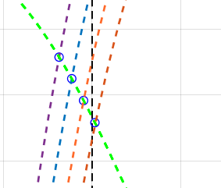
Analytical investigation:
Inhibited Steady State
h - nullcline
Threshold
Gw = 0
Gw = 0.2
Gw = 0.4
Gw = 0.6
With no external drive, increase the Gw
h - nullcline
Threshold
D = 0
D = 2
D = 4
D = 6
Gw = 0; increasing the drive

Slide 6
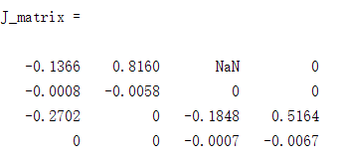
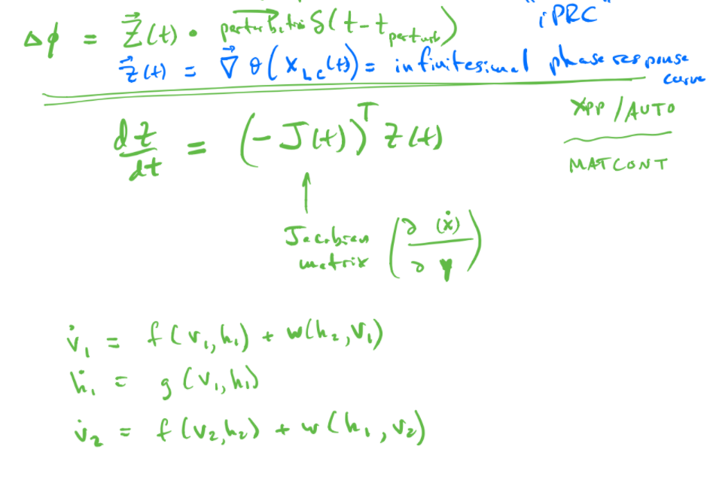
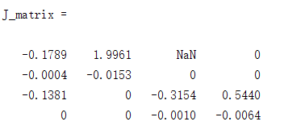
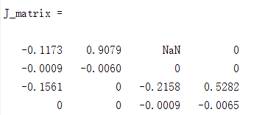
Mathematic approach
D = 0; Gw = 0; (silent)
D = 6; Gw = 0; (Driven oscillation)
D = 0; Gw = 0.6; (Self oscillation)
Some problem with the J matrix, working on it.

